Slide 1



7B Unit 2 基础

Slide 2





小试牛刀

Slide 3
一、句型转换
1. My uncle is going to Los Angeles next week.(对划线部分提问)
_____________________________________________________
2. Shall we make a plan for a day out next weekend?（同义句转换）
______________________ making a plan for a day out next weekend?
3. Amy is going to buy some food for the party.(改成一般疑问句并做否定回答)
_____________________________________________________
4. What does your aunt do?（同义句转换）
_____________________________________________________
5. Simon's bike doesn't work well, so he goes to school by bus.（同义句转换）
Something _________________________, so he goes to school by bus.
6. It usually takes him an hour to do his homework.（同义句转换）
He usually ____________________________________.
1. Where is your uncle going next week?
2. How/What about
3. Is Amy going to buy any food for the party? No, she isn't.
4. What's your aunt?
5. is wrong with Simon's bike
6. spends an hour doing his homework

Slide 4




目 录
壹
贰
叁
肆
旧知回顾
新知讲解
当堂练习
大展身手

Slide 5

旧知回顾
1. 以or结尾表示人的名词：visitor; actor; translator; inventor; collector; doctor; director
2. 以or结尾表示人的名词：
--What do you do?
-- ___________________.
A. I'm a cook. B. I'm cooking.
C. I'm fine. D. I'm going shopping.
第壹章
A

Slide 6

第贰章 新知讲解
1. It is adj for sb to do sth (adj说明、修饰做这件事情的意义) It is adj of sb to do sth（adj说明人的品质）
It's +n+ to do sth.
eg. It's a good idea______too much food at night.
A. eating B. to eat C. not to eat D. not eating
It's good_______ (stay) near the sea for a holiday.
B
to stay

Slide 7

2. like prep. 像 unlike (反) 某人外貌怎么样？
What’s sb like? = What does sb look like?= How does sb look?
be as...(adj/adv原级) as 和......一样 be the same as =be different from
as 作为 dress up as a ghost
某人性格怎么样？--What is sb like? --Sb is helpful and kind.
eg. --What ______your sister_______ ? --She is kind, and we all like her.
A. does; like B. does; look like C. are; like D. are; look like
--What does the boy look like? --He is ______his father. He also________eating mangoes.
A. likes; like B. like; like C. likes; likes D. like; likes
动词 dislike/like doing sth./ to do sth. would like to do sth.
--Do you know if Mary will play football with us this afternoon?
--Mary? Never! She_______playing football.
A. has disliked B. dislikes C. will dislike D. disliked
B
D
B

Slide 8


我爱学习
壹
3. waiter &waitress the waitress’s name
the waitresses’ names
4. How many 对可数名词复数提问
How much 对不可数名词提问和价格提问
How often How long (for +一段时间) How soon 将来（in +一段时间）
贰
叁
5. most of +n复数+ V复数 Most of the students are from China
most of + n不可数 + V单数 Most of energy comes from coal and oil.
at most/at least

Slide 9


学习爱我
6. helpful 愿意帮忙的; 有用的。 be helpful to sb
Jenny is __________ . She is ready__________ others at all times.
A. helpful; to help B. help; to help
C. helpful; helping D. help; helping
7. There’s something wrong with sth.=Something is wrong with sth.
= Something is broken.=Something doesn't work.
something/ anything/everything/ nothing/ someone... +adj/adv/else
8. ask/ order/ tell sb (not) to do sth make sb (not) do sth
My mother always _______ me do my homework on Saturday morning.
A. hopes B. asks C. makes D. tells
Mr Lee often tells us____________(not play) football in the street.
A
C
not to play

Slide 10
9. broken 损坏了的；破碎的 sth is broken break broke broken
break out break down break up
eg. --Do you know who________the glass?
--Sorry, I don't know. Who is the owner of the_______glass?
A. broken; broken B. broke; broken
C. breaks; broke D. broken; broke
10. fix sth 修理，安装 fix sth up 修理
B
第贰章
fix | 修理 | 表示使受到一定损坏或失灵的东西恢复其性能或机能，其对象范围很广，包括道路，机器和日常用品等。
mend | 修补 | 表示修补破损的东西，使其恢复原样，一般指较小的物品。

Slide 11

快乐学习
11. Anyone& any one anyone 用作代词，只能指人。any one +of 任何一个人/物
eg. Anyone here may take any one of the apples on the table.
12. be ready to help be/get ready to do sth be/get ready for (doing)... 为......做好准备
Mr Zhang is always_______others. People aroundour neighbourhood all like him very much.
A. ready to helping B. ready help
C. ready helping D. ready to help
13. be lucky to do sth
luck lucky a lucky dog luckily unlucky unluckily
D

Slide 12
14. wait for +sb/ n
wait for sb to do sth
can’t wait to do sth
can't stop/help doing sth
15.
the day/year... before yesterday | yesterday/last year | today/this year | tomorrow/ next year | The day after tomorrow/next year
16. How about.../What about...?询问情况，打听消息或向对方提出建议、要求等。后加名词（短语）、代词或动词ing 形式。
Shall we do...?/ Let’s do ... /Would you please do...? Why not do ...? Why don’t you do...?
eg. Would you please____________ (help ) me learn English?
help

Slide 13

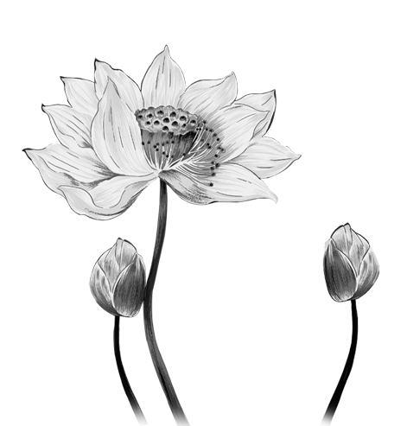
壹
贰
叁
17.
bring (brought) | 拿来，带来 指从别处带到说话处 | Bring your book to school tomorrow.
take (took) | 拿去，带去 把某人或某物带离说话处 | Please take this book to Lisa.
carry (carried) | 搬运，携带 无方向性 | He’s carrying a box on his back.
eg. Don't forget to bring your homework tomorrow and you can't take your exercise books out of the clssroom.

Slide 14

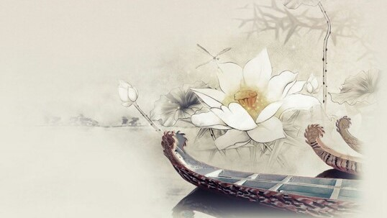
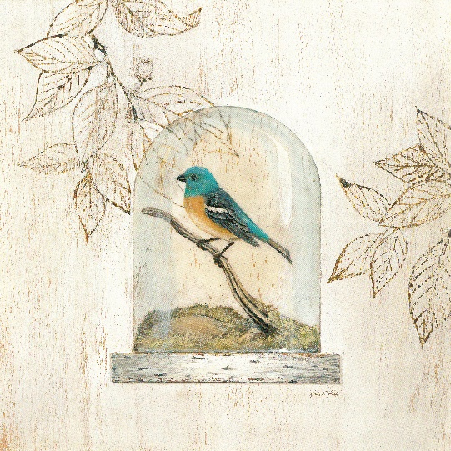
Don't give up
壹
贰
叁
18. He’s going to make a fire.
catch/be on fire 着火
light fire点火 play with fire玩火
19. police/family 做集体名词，译为“警察，警方”用作单数。
call the police 报警
policeman/policewoman postman
20. be good at/do well in 后接名词、代词或动词ing形式
be poor (bad)at /
do badly in 不擅长......

Slide 15
第叁章 当堂总结
壹
贰
叁
肆
三拿的用法
fix/mend区别
固定句型
like用法

Slide 16

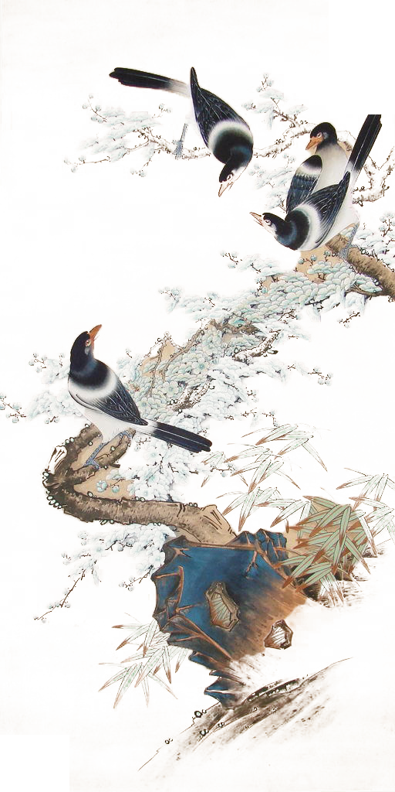

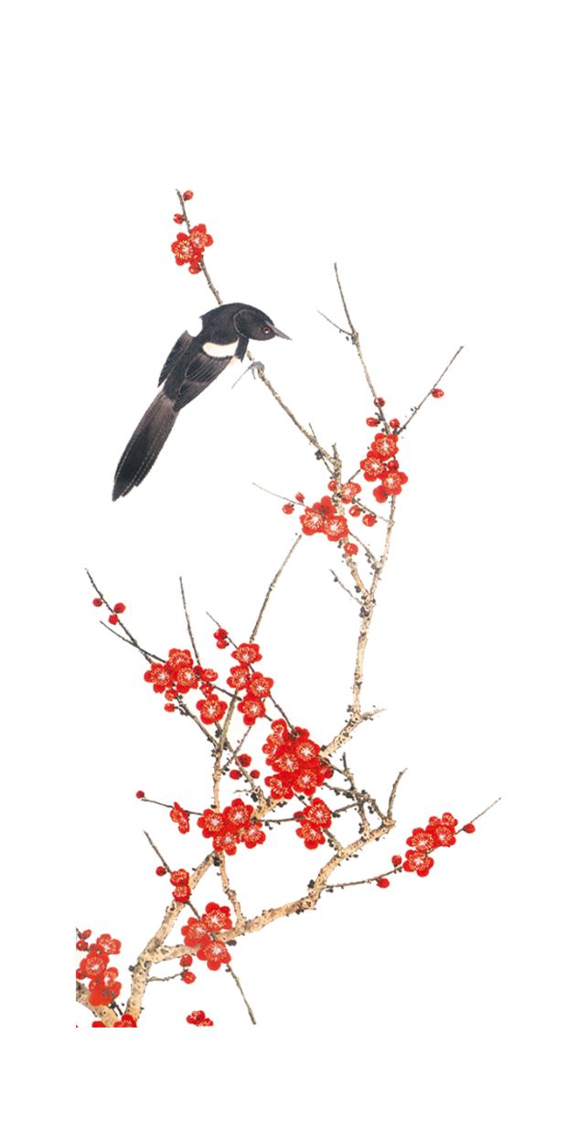
当堂练习

Slide 17


一、单项选择1. __ Father's Day is coming. Jerry will buy a new wallet for his father. A. A B. An C. The D. /2. --where is your teachers’ office? --our teachers’ office is on _______ floor of ______. A. fifth; Building Two B. the fifth; the Building Two C. fifth; the second building D. the fifth; Building Two3. Does Anna like watching TV and _________ a cup of coffee in her nice living room. A. enjoying B. enjoyed C. to enjoy D. enjoys4. Can you ______ it in English? A. speak B. talk C. say D. tell5. ______ a cold winter evening, the poor old man died. A. In B. On C. At D. For
DDACB

Slide 18

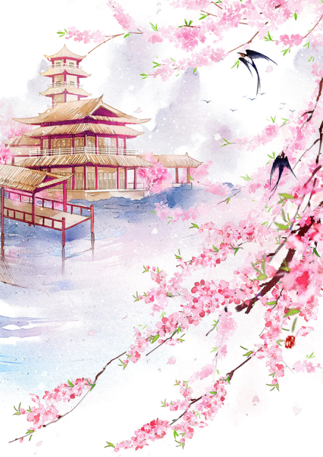
6. Shafi fell in love _____ coding after _______ programmers (程序员) work at his father’s office. A. of; watching B. to; watched C. at; watched D. with; watching7. Is Lihua always the last student _____ our classroom? A. leaves B. leaving C. to leave D. leave8. The music sounds __________. I’m sure you will like it. A. beautiful B. beautifully C. like good D. like badly9. I think _______important for us to learn English well. A. that is B. it is C. that will be D. is10. --Sandy, ______will your father come back from Beijing? --In ten days. A. how long B. how many C. how soon D. how often
DCABC

Slide 19

11. --Does Amy need help ______ her lessons? --No, she is good at all her subjects. A. to B. for C. from D. with12. --______ there _____ two table tennis matches this evening? --No, only one. A. Are; going to be B. Is; going to be C. Will have D. Are; going to have13. Many people ______happiness in helping others. A. ask B. invite C. find D. design14. The actors try to play ______ , but I don’t enjoy the play because I don't feel _______today. A. good; good B. well; well C. good; well D. well; good15. Look, there is a knock at the door. Maybe there’s _______outside. A. something B. anything C. someone D. anyone
DACBC

Slide 20

16. When people do not know what to wear to a party or how to design the home,
the _________will help them. A. policemen B. postmen C. artists D. waiters17. At the Fix-it Club, we need people with_____. A. great skills B. good hearing C. great interest D. good grades18. If she _________ tomorrow, I will finish the work by myself. A. doesn’t come B. will not come C. don’t come D. isn’t coming19. What great fun it is _________trees in the park on March 12th. A. plant B. to plant C. planting D. will plant20. --How far is it from the supermarket to your home? --It’s about________. A. 3miles far away B. 3miles away C. 3miles away from D. 3miles far away from
CAABB

Slide 21

第肆章 大显身手
6. Mr Li always _____________(检查) our homework carefully.
7. There will be some doctors and nurses among the __________(志愿者)
8. --What are you going to do this weekend, Amy?
--I am going to visit my grandparents, then go to the supermarket to do some __________ for them with my parents.
9. --Jimmy, do you have any brothers or sisters?
--I have two _________ sisters. I have no brothers. I am the youngest in my family.
10. --what grade are you and Neil in?
--Neil is in the 8th grade,and I am in the Grade 7. So I am one grade ________ him.
一、单词填空
1. The dictionary is very____________(有用的) to your English study.
2. ____________（组）of the girls are waiting on the playground.
3. The __________(布告) on the wall says “No smoking”.
4. --Mr.Lee, I am looking for the new house. Can you tell me something about the prices of different kinds of houses?
-- I am sorry I know little. But there are many pieces of ________(信息) on the internet.
5. On Halloween, we knock at our __________(邻居) doors and shout “trick or treat”
稳住 不慌
useful Groups notice information neighbours’
checks volunteers shopping elder below

Slide 22
Thank you

